Slide 1
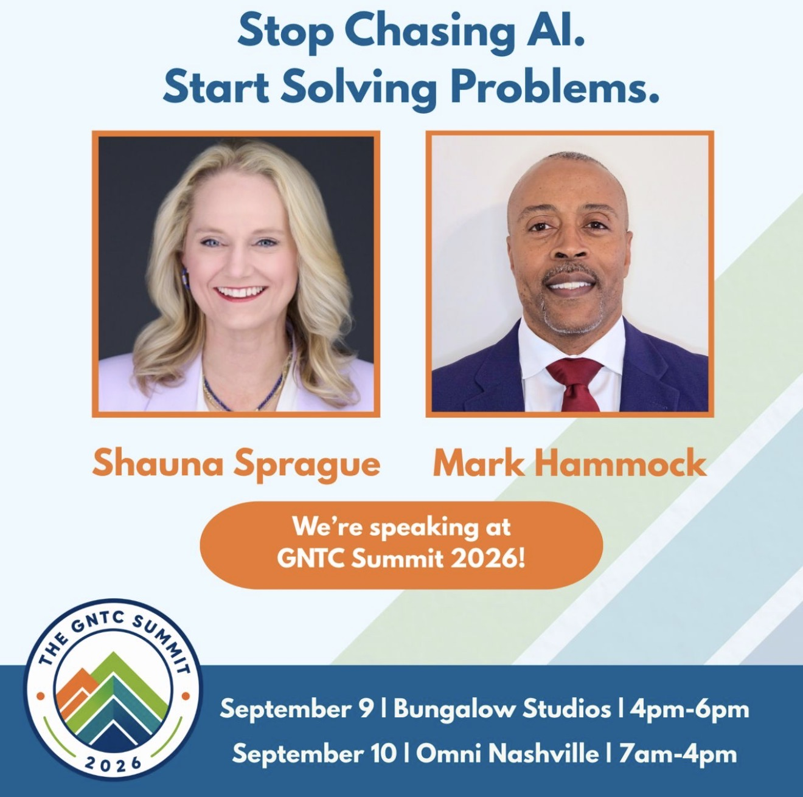

STOP CHASING AI.
START SOLVING
PROBLEMS.
Find the right problem. Prioritize it.
Build an MVP.
WORKSHOP
Elevate AI Studio

Slide 2
A problem-first path to an MVP
A useful product starts long before anyone opens a building tool.
1
2
3
4
Find
Define
Prioritize
Build
Look for costly friction
Name the user and consequence
Balance value, effort, and risk
Test one useful workflow
One painful problem. One important workflow. One measurable result.

Slide 3

The shiny object trap
Tool-first thinking often creates impressive demos that nobody urgently needs.
Tool first
Problem first
1. Discover a new AI tool
2. Search for something to build
3. Add features
4. Hope someone wants it
1. Find costly friction
2. Understand the user
3. Measure the current pain
4. Test the smallest useful fix
HIGH RISK OF WASTED WORK
FASTEST PATH TO EVIDENCE

Slide 4

Where good problems hide
Listen for recurring friction in normal work.
Repeat work
Scattered answers
Slow decisions
People do the same manual task again and again.
Information is hard to find or lives in several places.
People wait for data, approval, or someone with special knowledge.
Frequent mistakes
Repeated questions
One-person dependency
Copying, retyping, or missed steps create rework.
Customers or employees ask the same things every day.
A process stops when one key person is unavailable.
What happened this week that made someone say, 'There has to be a better way'?

Slide 5
A clear problem statement
A strong statement identifies the person, obstacle, and business consequence.
WHO
STRUGGLES TO
BECAUSE
WHICH CAUSES
[Type of user]
[Complete a task]
[Specific obstacle]
[Measurable consequence]
Example
Small business owners struggle to follow up with new leads because inquiries arrive through several channels, causing delayed responses and lost sales.
If the consequence is vague, the value will be hard to prove.

Slide 6
Problem or symptom?
Ask why until the solution targets the real source of the pain.
SYMPTOM
Reports take too long
WHY?
Employees gather information manually
WHY?
The information lives in different systems
ROOT PROBLEM
People cannot quickly access trusted, current information
Automating a broken process only helps it fail faster.

Slide 7

A simple prioritization score
Score each factor from 1 to 5. Subtract risk.
IMPACT
Time, money, or frustration removed
FREQUENCY
How often the problem happens
PRIORITY SCORE
URGENCY
How motivated people are now
Impact + Frequency + Urgency + Feasibility
FEASIBILITY
How quickly you can test it
- Risk
RISK
What happens if the solution is wrong
Start with a clear user, frequent pain, accessible data, and a low-risk first test.

Slide 8


Does AI belong in the solution?
Use AI when it adds value. Use traditional software when the rules are predictable.
AI may help
Traditional software may be better
Summarize unstructured information
Draft or transform content
Find patterns across text
Classify or route requests
Answer questions using approved information
Rules are fixed and predictable
The result must always be exact
A form or calculation solves the problem
A filter or notification is enough
AI adds cost without adding value
Choose the simplest technology that solves the problem.

Slide 9
The MVP contract
Five decisions keep the first version small and testable.
1
The user is...
2
The problem is...
3
The MVP helps them...
4
The essential workflow is...
5
We will know it works when...
ONE USER
ONE WORKFLOW
ONE RESULT

Slide 10

What makes the first version?
Separate the test from the wish list.
MUST HAVE
LATER
REMOVE
Needed to test the main idea
Useful after the idea works
Interesting but unrelated to the test
One user type
One workflow
Human review
One success measure
Extra integrations
More user roles
Automation
Advanced reporting
Every use case
Complex billing
Perfect branding
Nice-to-have features

Slide 11
Build the MVP in Lovable
Give Lovable enough context to build the right test.
1
User + problem
2
One workflow
3
Minimum screens
4
Data needed
5
Rules + limits
6
Generate
7
Test
8
Improve
EXAMPLE STARTING PROMPT
Build a simple app for small business owners. Collect a new customer inquiry, create a draft follow-up, and require the user to approve it. Do not send messages automatically or collect sensitive personal information. Clearly warn that AI output may contain errors.

Slide 12


Security belongs in the MVP
Add safeguards before real users and real data enter the product.
Collect less data
Protect access
Ask only for information the product needs.
Use secure secret storage, sign-in, and database permissions.
Keep a human involved
Test failures
Require review before important or high-impact actions.
Try incorrect, harmful, biased, and unexpected inputs.
Check every provider
Plan for control
Review privacy, retention, and model-training policies.
Let users report errors and correct or delete stored data.
If public exposure would create a serious problem, do not enter the information until you understand how the tool handles it.

Slide 13
Responsible use and clear disclaimers
This product uses artificial intelligence to generate or assist with content. AI-generated results may be incomplete, incorrect, or inappropriate. Review all outputs before relying on them.
Tell users what AI does
Explain its role in plain language.
Set clear limits
Add legal, medical, or financial disclaimers when relevant.
Explain data handling
Say what you collect, store, share, and delete.
Get qualified review
High-impact and regulated products need legal and security review.
One painful problem. One useful workflow. One real person to test it.
Sample disclaimer language is a starting point, not legal advice.

Slide 14

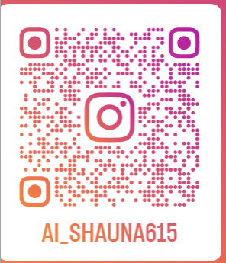
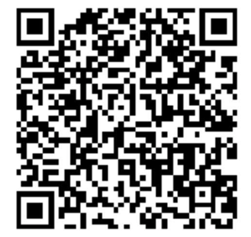


Responsible use and clear disclaimers
Contact Us:
Shauna Sprague
Mark Hammock
Instagram
LinkedIn
https://elevateaistudio.com/
Follow for more AI tips and tricks
Sample disclaimer language is a starting point, not legal advice.

