Slide 1

CLAUDE 101
Desktop Setup & Your First Automations
A 40-Minute Working Session | Elevate AI Studio
Notes:
Welcome. Today we're doing something different from a typical intro session — we're going to leave with real things actually running: your own about-me file, an inbox that sorts itself, and a morning briefing waiting for you every day. We're moving fast, so every prompt will be on screen to copy — you won't need to type much.

Slide 2
What We're Covering Today
40 minutes, start to finish
0:00
Welcome
0:03
Install & Tour Claude Desktop
0:10
Connectors, Plugins & Skills
0:16
Build Your aboutme.md
0:22
Set Up Email Triage
0:30
Set Up Your Daily Digest
0:36
Selling AI-Made Products: What to Disclose
0:39
Wrap-Up
Elevate AI Studio | Claude 101
2
Notes:
Walk through the agenda quickly — don't dwell. Mention that email triage (0:22) is the centerpiece and daily digest builds directly on it. If you're worried about time, tell the room now: 'If we run long, the AI disclosure section shrinks to one slide, not the automation building.'

Slide 3

STEP 1
Install & Tour Claude Desktop
Download from claude.ai/download and sign in with your existing account. Desktop is what makes connectors, Cowork, and scheduled tasks work smoothly.
Chat
Cowork
Code
Regular back-and-forth conversation — same as the web app.
Where Claude does multi-step work and runs scheduled tasks.
For technical/development work — good to know it's there.
Good to know: installing the app doesn't automatically give Claude access to your computer or accounts. It only sees what you upload or explicitly connect — nothing happens silently.
Elevate AI Studio | Claude 101
3
Notes:
If everyone did the pre-work (installed + signed in before class), this is just a 90-second tour. If some didn't, have them install now while you talk over the tour for everyone else — don't let one slow install stall the whole room.

Slide 4



STEP 2
Connectors, Plugins & Skills
Connectors
Skills
Plugins
Link Claude to your real tools — Gmail, Calendar, Drive, Slack. Settings → Connectors.
Reusable instructions for a task you do often — a saved playbook Claude follows automatically. Settings → Skills.
Skills (and other tools) bundled together, often shared by your organization so a team uses one standard approach.
Give it access
Teach it a task
Share it with a team
One-sentence version: Connectors give Claude access to your tools. Skills teach it a repeatable task. Plugins are skills packaged up for a whole team to share.
Elevate AI Studio | Claude 101
4
Notes:
Keep this conceptual — a map of what each word means, not hands-on practice yet (that comes with email triage next). Mention the permission model briefly: for each connector you choose Always allow, Needs approval, or Blocked per action type. Don't install a plugin live unless your org already has one relevant to this audience.

Slide 5

STEP 3
Build Your aboutme.md
The single highest-leverage thing you'll do today: giving Claude durable context about who you are, so you stop re-explaining yourself every conversation.
I want to create an "aboutme.md" file that you can use as background
context in every conversation we have. Ask me questions one at a time
to build it until you are 95% sure you understand me — cover my name, my role/title, what I'm responsible for
day to day, my working style, my current priorities, and anything I
frequently need help with. Once you have my answers, write the final
file in clean markdown with headers.
Then say: "Please remember the key facts from the aboutme.md we just built, so you have this context in future chats too."
Elevate AI Studio | Claude 101
5
Notes:
Paste the prompt into a new chat and let Claude interview everyone — walk the room while this happens. If time is short, cap this at 4 minutes and let people finish the interview after class. The file being started matters more than it being perfect today.

Slide 6

STEP 4 — THE CENTERPIECE
Set Up Email Triage
Set up a recurring scheduled task that triages my email inbox.
Each time it runs:
1. Look only at emails NOT already sorted into a category.
2. Apply category rules, in order, and label matching emails:
- "[Category 1]": [trigger] -> label "[Folder 1]"
- "[Category 2]": [trigger] -> label "[Folder 2]"
3. Anything left over goes in a label called "Other" to review.
4. Run this every [hourly / daily at 8am / weekday morning].
Ask me clarifying questions before you finalize the schedule.
Requires: Gmail connected first (Settings → Connectors → Gmail). Task lives in the Scheduled tab in Cowork — run it early to test instead of waiting.
Elevate AI Studio | Claude 101
6
Notes:
This segment has the best 'wow' moment of the session — leave room for it rather than rushing past. Claude will ask clarifying questions: exact schedule, exact categories, approval mode — let each person answer for their own inbox. If someone's setup gets complicated, tell them to simplify to one category today and refine later.

Slide 7

STEP 5
Set Up Your Daily Digest
Now that email sorts itself, layer on a morning briefing so you never open the inbox cold.
Set up a daily scheduled task, run every morning at [time], that
gives me a short digest:
1. Summarize important emails from the last 24 hours, especially
anything in a category that usually needs my attention.
2. List today's calendar events, in order, if Calendar is connected.
3. Note anything sitting in my "Other" folder for more than a day.
4. Keep it to one short, skimmable summary — headlines, not
paragraphs.
Elevate AI Studio | Claude 101
7
Notes:
If Calendar isn't connected for most of the room, don't stop to connect it live — the digest still works on email alone, and Claude will just skip that part. Mention Calendar as a 'one more connector, same process' upgrade for later.

Slide 8

STEP 6
Selling AI-Made Products: What to Disclose
The simple test: if a reasonable customer would assume a photo, testimonial, or description is real or human-made when it isn't — disclose it.
Product photos
AI-written descriptions
AI-generated art/designs
"Product images shown include AI-generated elements."
"This listing description was created with AI assistance."
"This design was created using AI tools."
Why this matters now: the FTC treats undisclosed AI content as a potentially deceptive practice; states like California and New York have their own rules; the EU AI Act requires labeling for anyone selling into the EU. Marketplace policies (Etsy, Amazon) vary and change — check yours.
Not legal advice — rules are shifting by state and platform. Selling at real volume? Talk to someone qualified.
Elevate AI Studio | Claude 101
8
Notes:
Say this explicitly: "I'm not a lawyer, and this isn't legal advice — the rules here are genuinely still shifting by state and by platform. If you're selling at any real volume, this is worth a real conversation with someone qualified. Today's goal is just: know that this is a live legal area, not a courtesy."

Slide 9

Recap
Claude Desktop is installed
and you know what connectors, skills, and plugins each do.
Your aboutme.md is built
so you stop re-explaining yourself every conversation.
Your inbox sorts itself
and a digest is waiting for you every morning.
AI disclosure is a live legal question
check your platform's policy before you sell.
Elevate AI Studio | Claude 101
9
Notes:
Recap out loud, one line each. Everything built today keeps running after class — check the Scheduled tab in Cowork any time to see it, pause it, or tweak it.

Slide 10
Everything you built today keeps running.
Check the Scheduled tab in Cowork any time to view, pause, or edit it.
Next Session: Document Automation & Calendar Management
Elevate AI Studio
Notes:
Thank the room. Point to next session. If collecting feedback or gauging interest for future topics, this is the moment — people are warmest right after a good hands-on segment.

Slide 11
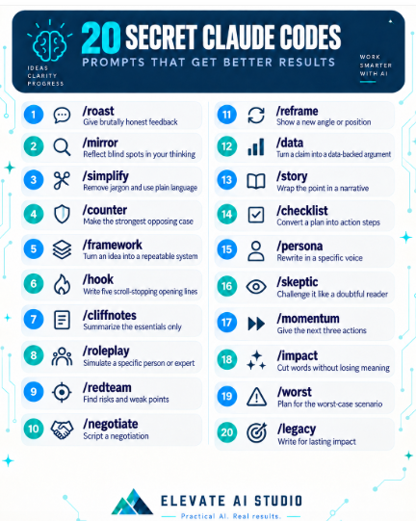
Bonus Shortcut Codes (ELI5)
Elevate AI Studio | Claude 101
9
Notes:
Recap out loud, one line each. Everything built today keeps running after class — check the Scheduled tab in Cowork any time to see it, pause it, or tweak it.

Slide 12
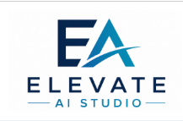

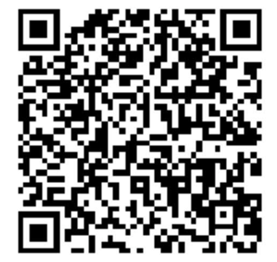


Responsible use and clear disclaimers
Contact Me:
Instagram
LinkedIn
https://elevateaistudio.com/
Follow for more AI tips and tricks
Sample disclaimer language is a starting point, not legal advice.

